Slide 1
Module IV
Empowerment and Team Work

Slide 2
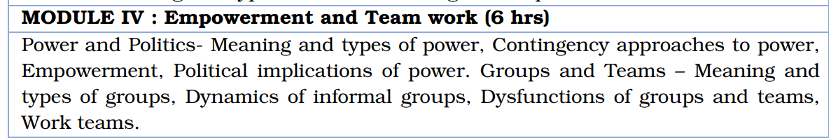
Syllabus

Slide 3
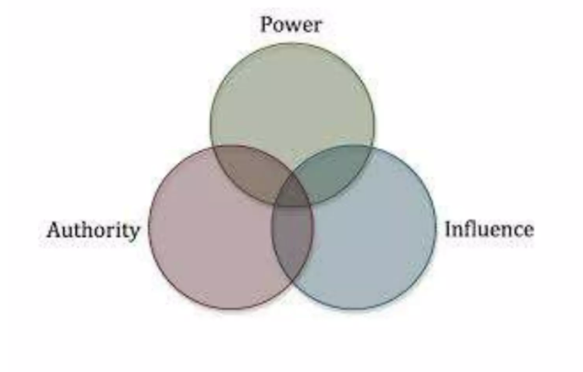
Meaning of Power
Dynamics of power—How to use it and how to abuse it
“Probability that one actor within a social relationship will be in a position to carry out his own will despite resistance”
Power, Influence and Authority

Slide 4
Power, Influence and Authority
Power
Ability to influence another person
Ability to get an individual or group to do something
Get the person or group to change in some way
Ability to manipulate or change others
Influence
Process of affecting the thoughts, behavior, and feelings of another person
Authority
Right to influence another person
Legitimatizes and is a source of power.
Authority is the right to manipulate or change others.
Power need not be legitimate

Slide 5
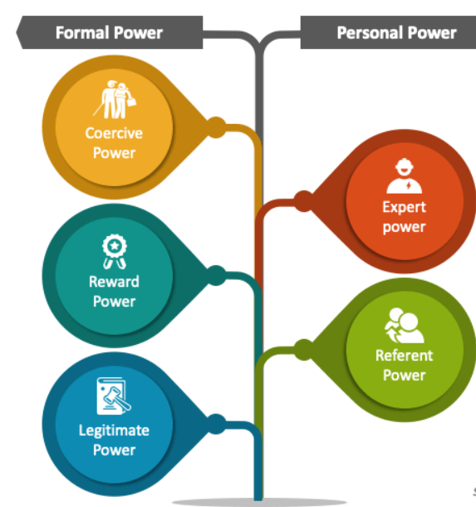
Types of Power : French and Raven

Slide 6
Types of Power : Reward Power
Based on a person’s ability to control resources and reward others.
Target of this power must value these rewards
Managers have many potential rewards,
Pay increases
Promotions
Valuable information
Favorable work assignments
More responsibility
New equipment
Praise, feedback

Slide 7
Types of Power : Reward Power
Recipient holds the key
If managers offer their people what they think are rewards, but the people do not value them, then managers do not really have reward power
Managers may not really have the rewards to dispense, but as long as their people think they have it, they do indeed have reward power

Slide 8
Types of Power : Coercive Power
Power depends on fear
Person with coercive power has the ability to
Inflict punishment
Aversive consequences on another person
Mo make threats that the other person believes will result in punishment or undesirable outcomes
Managers frequently have coercive power in that they can fire or demote people who work for them
Manager can also directly or indirectly threaten an employee with these punishing consequences

Slide 9
Types of Power : Legitimate Power
Stems from the internalized values of the other persons that give the legitimate right to the agent to influence them
Others feel they have the obligation to accept this power.
Almost identical to authority and is closely aligned with both reward and coercive power
Unlike reward and coercive power
Not depend on the relationships with others but rather on the position or role that the person holds

Slide 10
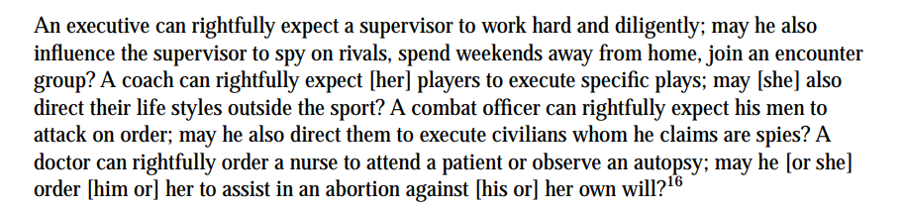
Types of Power : Legitimate Power
3 major sources
Prevailing cultural values of a society, organization, or group determine what is legitimate
Accepted social structure
Being designated as the agent or representative of a powerful person or group

Slide 11
Types of Power : Referent Power
Based on interpersonal attraction
Leader's ability to influence others based on admiration, respect, loyalty, or a desire for approval
A team captain who inspires their teammates through their positive attitude and work ethic, even if they don't have formal authority

Slide 12
Types of Power : Expert Power
Agent has knowledge target needs
If a highly successful football coach gives an aspiring young player some advice on how to do a new block, he will be closely listened to—he will be granted expert power.
Coach has expert power in this case because he is so knowledgeable about football
In organizations, staff specialists have expert power in their functional areas but not outside them

Slide 13
Types of Power : Expert Power
Expert power is highly selective, and, besides credibility, the agent must also have trustworthiness and relevance
Expert Power!

Slide 14
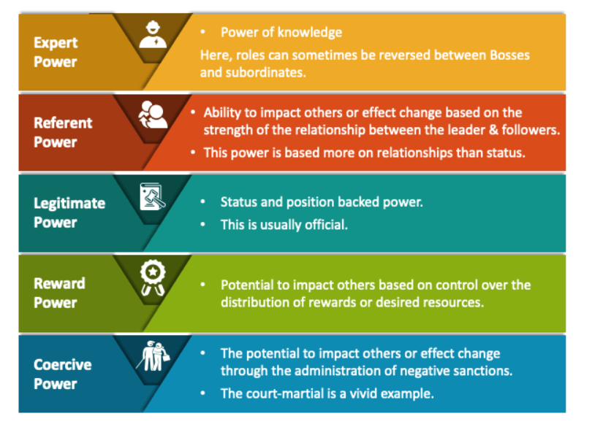
Types of Power

Slide 15
Contingency Approaches to Power
No particular power base is effective in all situations
Effectiveness of power depends upon the situation requirements prevailing at the time of use of power
A Successful Manager is one who is aware of existence of multiple bases of power in work situations
Effectiveness of different power depends on the nature of managerial, subordinate and organization variables

Slide 16
Contingency Approaches to Power
Contingency approaches to power have emerged to describe the right place or position in the organization
Managers need
Control over resources such as budgets, physical facilities, and positions that can be used to cultivate allies and supporters
Control over or extensive access to information—about the organization’s activities
Formal authority

Slide 17
Influenceability of the Targets of Power
Characteristics important to the influenceability of targets:
Dependency
2. Uncertainty
3. Personality
4. Intelligence
5. Gender
6. Age
7. Culture

Slide 18
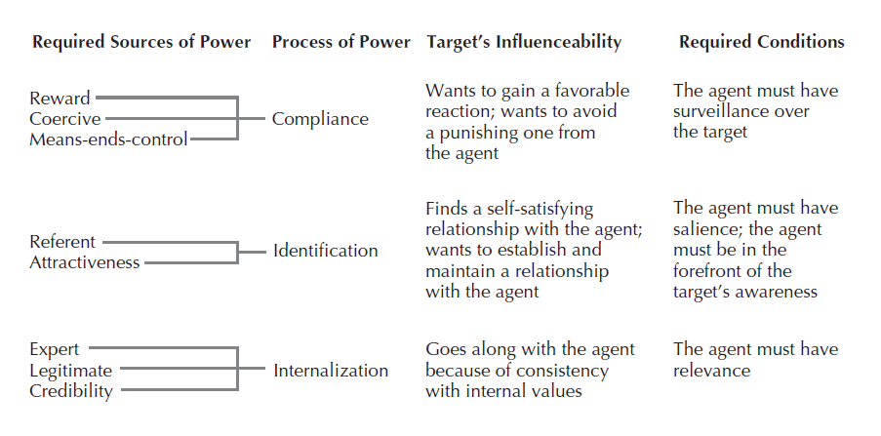
An Overall Contingency Model for Power
Overall Contingency Model of Power Based on the French-Raven and Herbert Kelman Theories

Slide 19
The Two Faces of Power
According to social psychologist David McClelland
Negative Personal Power:
Always “I” oriented
Focus on personal gain, exploitative and manipulative to achieve their goals, lack of concern for others, Destructive behavior(aggression, bullying)
Positive Social Power:
“We” oriented
Focus on social benefit(improving the organization, helping others), Collaborative and empowering to achieve goals, Concern for others, constructive behavior (innovation, teamwork).

Slide 20
Empowerment
“Recognizing and releasing into the organization the power that people have in their wealth of useful knowledge and internal motivation”
Empowerment is the authority to make decisions within one’s area of responsibility.
Two characteristics
Employees are encouraged to use their own initiative, “Just do it.” approach.
Empowered employees are given not only the authority but also the resources
Creating a “shared purpose among employees, encouraging greater collaboration, delivering enhanced value to customers.”

Slide 21
Complexity of Empowerment
Assumes that employees
Willing to accept responsibility
Improve their daily work processes and relationships
Empowerment and participation have been found to work best
When they open new avenues for action among all members of the organization
Strengthen their resolve to go along with the new ideas
Innovation Implications
Access to Information
Accountability and Responsibility

Slide 22
Putting Empowerment into Action
How managers can implement empowerment??
Two common approaches are:
(1) kaizen (continuous improvement) and “just do it” principles
(2) Trust building
Empowerment: Sharing of social power in an organization
Individual employees share goals and combine efforts to reach those goals
Fosters creativity and a stronger stake in the organization’s outcomes and future

Slide 23
Political Perspective of Power in Organizations
Politics is exercise of powers for advantage or achieve your purpose
Four postulates of power in organizations that help focus on the political realities (Walter Nord)
Organizations are composed of coalitions that compete with one another for resources, energy, and influence
Various coalitions will seek to protect their interests and positions of influence
Unequal distribution of power itself has dehumanizing effects
Exercise of power within organizations is one very crucial aspect of the exercise of power within the larger social system

Slide 24
Political Perspective of Power in Organizations
Areas that identifies organizations are political are:
Resources
2. Decisions
3. Goals
4. Technology and external environment
5. Change

Slide 25
Specific Political Strategies for Power Acquisition
Taxonomy of political strategies include:
Information strategy—Targets political decision makers by providing information through lobbying or supplying position papers or technical reports
2.Financial incentive strategy—Targets political decision makers by providing financial incentives
3.Constituency building strategy—Targets political decision makers indirectly through constituent support .
Self study Topic: Political strategies for attaining power in Organizations

Slide 26
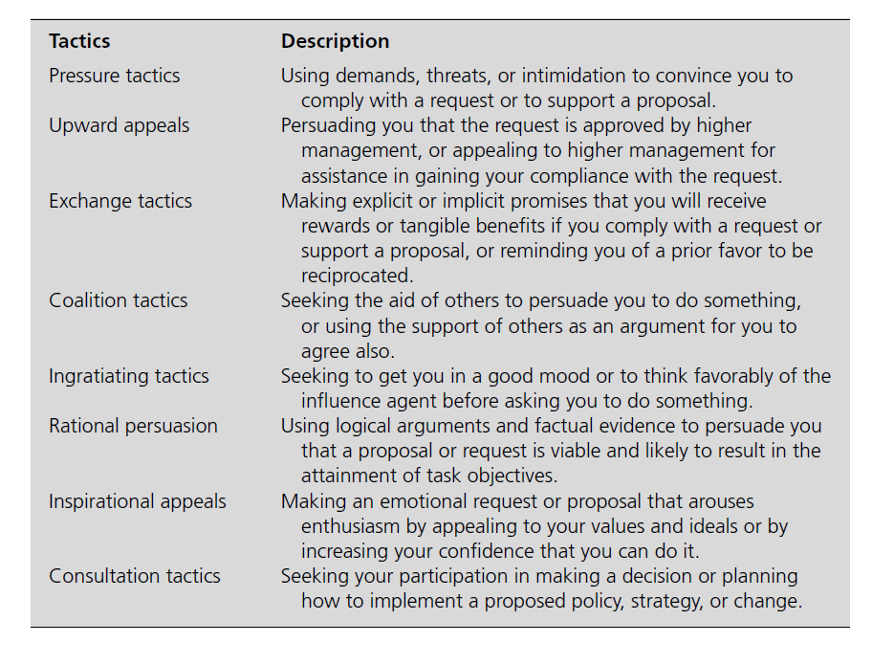
Political Tactics:

Slide 27
DuBrin’s list of political strategies
Maintain Alliances with Powerful People
Embrace or Demolish
Divide and Rule
Manipulate Classified Information
Make a quick showing
Avoid Decisive Engagement (Fabianism)
Attacking and Blaming Others
Progress One Step at a Time (Camel’s Head in the Tent)
Wait for a Crisis (Things Must Get Worse Before They Get Better)
Be Aware of Resource Dependence

Slide 28
Groups and Teams : Meaning of Group
If a group exists in an organization, its members:
1. Are motivated to join
2. Perceive the group as a unified unit of interacting people
3. Contribute in various amounts to the group processes
4. Reach agreements and have disagreements through various forms of interaction
Group dynamics: How a group should be organized and conducted

Slide 29
Groups and Teams : Dynamics of Group Formation
Why do individuals form into groups?
Propinquity: Individuals affiliate with one another because of spatial or geographical proximity
Theories of Group Formation
1. Classic theory of George Homans based on activities, interactions, and sentiments
2. Theodore Newcomb’s classic balance theory of group formation
Persons are attracted to one another on the basis of similar attitudes toward commonly relevant objects and goals

Slide 30
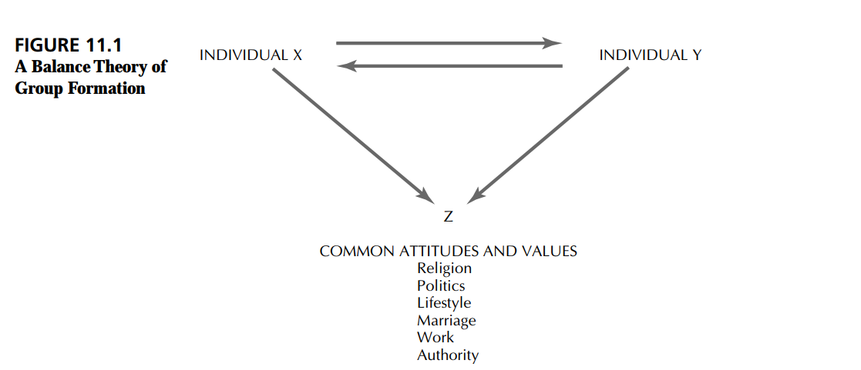
Groups and Teams : Dynamics of Group Formation

Slide 31
Groups and Teams : Dynamics of Group Formation
3. Exchange Theory : Based on reward-cost outcomes of interaction
A minimum positive level (rewards greater than costs) of an outcome must exist in order for attraction or affiliation to take place
Propinquity, interaction, and common attitudes all have roles in exchange theory

Slide 32
Groups and Teams : Stages of group development
1. Forming : Initial stage is marked by uncertainty and even confusion
2. Storming: Stage of development is characterized by conflict and confrontation.
3. Norming : Members begin to settle into cooperation and collaboration. They have a “we” feeling with high cohesion, group identity, and camaraderie.
4. Performing : Group is fully functioning and devoted to effectively accomplishing the tasks agreed on in the norming stage
5. Adjourning : End of the group
READING EXERCISE: “PRACTICALITIES OF GROUP”

Slide 33
Groups and Teams : Types of Groups
Primary Groups
Small group and primary group
Small group: Meet only the criterion of small size
Primary group: Feeling of comradeship, loyalty, and a common sense of values
Eg: Family and the peer group
Use the power of primary groups by organizing employees into self-managed teams

Slide 34
Groups and Teams : Types of Groups
2. Coalitions
Group of individuals or groups who temporarily collaborate to achieve a common goal
1. Interacting group of individuals
2. Deliberately constructed by the members for a specific purpose
3. Independent of the formal organization’s structure
4. Lacking a formal internal structure
5. Mutual perception of membership
6. Issue-oriented to advance the purposes of the members
7. External forms
8. Concerted member action, act as a group

Slide 35
Groups and Teams : Types of Groups
2. Other Types
Membership and reference groups
Membership groups: Those to which the individual actually belongs
Reference groups: Those to which an individual would like to belong
In-Groups and Out-groups
In-groups: Those who have or share the dominant values
Out-groups: Those on the outside looking in

Slide 36
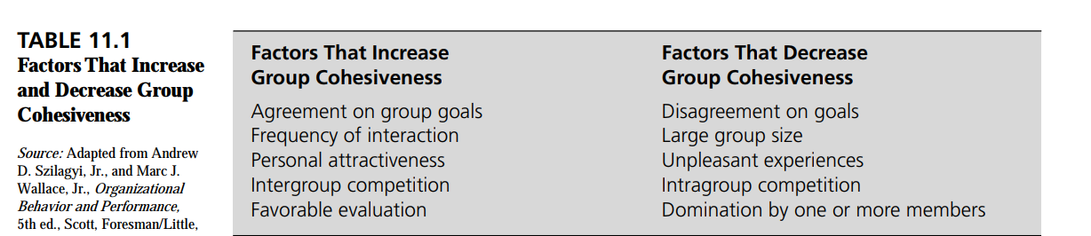
Groups and Teams : Group Cohesiveness

Slide 37
Groups and Teams : Group/Team Effectiveness
Following ways to use groups to enhance satisfaction and performance:
1. Organizing work around intact groups
2. Having groups charged with selection, training, and rewarding of members
3. Using groups to enforce strong norms for behavior, with group involvement in off-the job as well as on-the-job behavior
4. Distributing resources on a group rather than an individual basis
5. Allowing and perhaps even promoting intergroup rivalry so as to build within-group solidarity

Slide 38
Groups and Teams : Group/Team Effectiveness
Following ways to use groups to enhance satisfaction and performance:
1. Organizing work around intact groups
2. Having groups charged with selection, training, and rewarding of members
3. Using groups to enforce strong norms for behavior, with group involvement in off-the job as well as on-the-job behavior
4. Distributing resources on a group rather than an individual basis
5. Allowing and perhaps even promoting intergroup rivalry so as to build within-group solidarity

Slide 39
Groups and Teams : Group/Team Effectiveness
Three factors that seem to play the major role in determining group effectiveness:
Task interdependence (how closely group members work together);
Outcome interdependence (whether and how group performance is rewarded);
Potency (members’ belief that the group can be effective)

Slide 40
Dynamics of Informal Groups
Formal group has officially prescribed goals and relationships, whereas the informal one does not
Smallest units of analysis in group dynamics are norms and roles
Norms will be strongly enforced by work groups if they:
1. Aid in group survival and provision of benefits
2. Simplify or make predictable the behavior expected of group members
3. Help the group avoid embarrassing interpersonal problems
4. Express the central values or goals of the group and clarify what is distinctive about the group’s identity

Slide 41
Dynamics of Informal Groups
Role : Position that can be acted out by an individual
Some informal roles found in work groups include the following:
1. Boundary spanner : Acts as a facilitator and bridge between units
2. Buffer: Protects and filters negative or disappointing news or information that might cause group members to be upset and cause morale to suffer.
3. Lobbyist: Promotes and tells others how successful and important the group is to outsiders.
4. Negotiator: Empowered by the group to act on its behalf to get resources and make deals.
5. Spokesperson: Voice of the group

Slide 42
Dynamics of Informal Groups
Practical benefits that can be derived from the informal organization:
1. Makes for a more effective total system
2. Lightens the workload on management
3. Fills in gaps in a manager’s abilities
4. Provides a safety valve for employee emotions
5. Improves communication

Slide 43
Dysfunctions of Groups and Teams
Norm Violation and Role Ambiguity/Conflict
Group norms that are violated can result in antisocial behaviors.
At the extreme, these include
Sexual harassment
Theft
Lying
Spreading rumors
Withholding effort
Absenteeism

Slide 44
Dysfunctions of Groups and Teams
Norm Violation and Role Ambiguity/Conflict
Role ambiguity: “Doesn’t know what he’s supposed to be doing”
Unclear job descriptions
Incomplete orders given by a manager
Inexperience
Role conflict occurs when the employee or team member is:
Asked to perform conflicting tasks or
Required to perform a task that conflicts with his or her own personal values

Slide 45
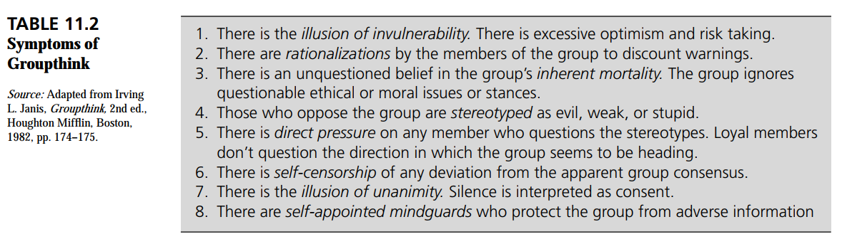
Dysfunctions of Groups and Teams
2. The Groupthink, Conformity Problem
Group Think: Deterioration of mental efficiency, reality testing, and moral judgment that results from in group pressures
Groupthink results from the pressures on individual members to conform and reach consensus

Slide 46
Dysfunctions of Groups and Teams
3. Risky Shift Phenomenon : A group may make more risky decisions than the individual members would on their own
4. Social Loafing
When members reduce their effort and performance levels when acting as part of a group
Primary causes include
Lack of performance feedback within the group
Tasks that are not intrinsically motivating
Situations in which the performances of others will cover for the reduced effort given by some members
“Sucker effect” of not wanting to do more than the perception of effort being given by others

Slide 47
Work Teams: Difference between Work group and Teams
1. The work group has a strong, clearly focused leader; the team has shared leadership roles
2. The work group has individual accountability; the team has individual and mutual accountability.
3. The work group’s purpose is the same as the organization’s; the team has a specific purpose.
4. The work group has individual work-products; the team has collective work-products.
5. The work group runs efficient meetings; the team encourages open-ended, active problem solving meetings.
6. The work group measures effectiveness indirectly, the team measures performance directly by assessing collective work-products.
7. The work group discusses, decides, and delegates; the team discusses, decides, and does
real work

Slide 48
Work Teams: Cross-Functional Teams
Teams made up of individuals from various departments or functional specialities
Improve productivity by establishing cross-functional teams
To improve coordination with cross-functional teams, organizations can carry out five steps.
(1) choosing the membership carefully,
(2) clearly establishing the purpose of the team,
(3) ensuring that everyone understands how the group will function
(4) conducting intensive team building up front so that everyone learns how to interact effectively,
(5) achieving noticeable results so that morale remains high and the members can see the impact of their efforts

Slide 49
Work Teams: Virtual Teams
Groups be made up of members in face-to-face interaction is no longer necessary
Advanced information technology
Increasing globalization
Need for speed
Communicate at a distance through electronic means
Members performing knowledge-based tasks in remote locations can become members
“Virtual teams are groups of people who work interdependently with shared purpose across space, time, and organization boundaries using technology to communicate and collaborate”
Synchronous Technology Vs Asynchronous technology

Slide 50
Work Teams: Self Managed Teams
Teams are being set up or are evolving into being self-managed as part of the empowerment movement
“Group of employees who are responsible for managing & performing technical tasks that result in product/service being delivered to an internal/external customer.”
Individual problems included the following:
1. Team members aren’t willing to give up past practices or set aside power and position.
2. Not all team members have the ability, knowledge, or skill to contribute to the group.
3. As team members, workers often face conflicts or challenges to their own personal beliefs.

Slide 51
Work Teams: Improve the effectiveness
Team building
Collaboration
Leadership
Understanding of cultural issues in global situations

Slide 52
Work Teams: Team Building
Work groups require time and training before they develop into productive and cohesive units
Effective team building establishes a sense of ownership and partnership
Allows members to see the team as a unit and as an attractive work arrangement
Team building succeeds when individuals share collective intelligence and experience a sense of empowerment and engagement.
Team building involves rapid learning, which takes place when there is a free-flowing generation of ideas
READING EXERCISE: Training Guidelines for Developing Effective Self Managed Teams

Slide 53
Work Teams: Team Building
Five key areas that should be monitored and measured include:
The team’s mission,
Goal achievements,
Feelings of empowerment,
Communications,
Roles and norms that are positive
Members should be emotionally intelligent, rather than just have raw intelligence (i.e., IQ)

Slide 54
Work Teams: Collaboration
Effective group leaders do not act alone
Assemble a group of highly talented people
Figure out how to get the most creative efforts out of everyone by effectively organizing them collaborative efforts
Computer “open-source” operating system Linux and the also free Web browser Firefox
Developed by essentially a voluntary, self organizing community of thousands of programmers and companies

Slide 55
Work Teams: Group Leadership
Two key ways in which leaders may affect performance of groups:
How they select members
The tactics they use to affect those members
Team leaders engaged to foster team effectiveness
Structuring the team and establishing its purposes
Arranging for the resources a team needs for its work
Removing organizational roadblocks
Helping individual members strengthen their personal contributions
Working with the team as a whole to help members use their collective resources

Slide 56
Work Teams: Group Leadership
Effective leaders know
How to teach
How to share the glory by acknowledging group success
How to gain the trust of their team members
When team leaders exhibit positivity, their members tended to be more positive

Slide 57
Work Teams: Cultural/Global issues
Global teams operating in a multicultural environment is inevitable
Certain cultural values lead to resistance to teams
Homogenous and highly heterogeneous teams outperformed moderately heterogeneous groups in the long run
Guidelines would include:
Careful selection of team
Adapting to each culture
Changing implementation of teams for each culture
Respecting local laws
Shared perceptions of procedural justice

Slide 58
THANK YOU

